Slide 1


Security Training

Slide 2


Let’s raise the level of information security in the company
It’s important that we learn to:
Choose strong passwords
Be vigilant in the office
Identify suspicious links and emails, and avoid them
Correctly distribute the level of privileges among employees

Slide 3
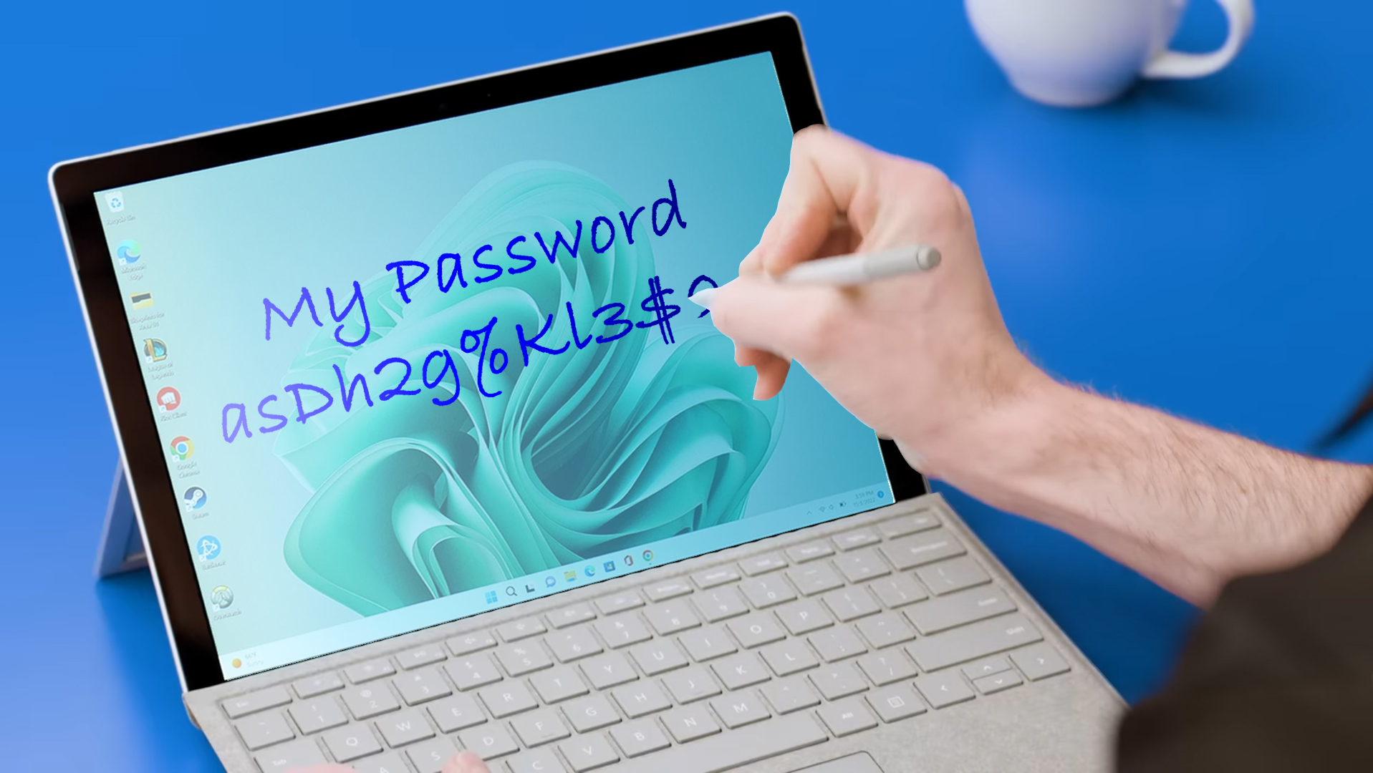

Slide 4

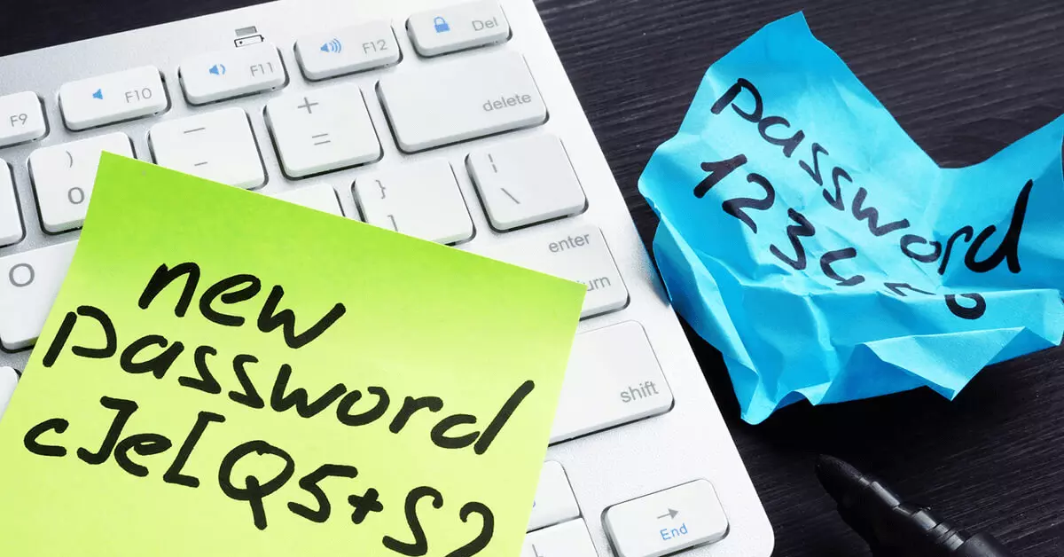
It’s important to choose a strong password!
A strong password includes:
At least 10 characters
A combination of small
and uppercase letters
At least one number
At least one symbol * Change passwords often!
*** It’s important to make sure that our password does not resemble
names, words, or numbers that are meaningful to us!

Slide 5

In addition,
It’s important to choose different passwords
for different devices and accounts!
To avoid providing direct access to all of our accounts and devices
In case one of our passwords was compromised.

Slide 6

Vigilant

Slide 7

There are many tempting links,
And many that seem very innocent.

Slide 8
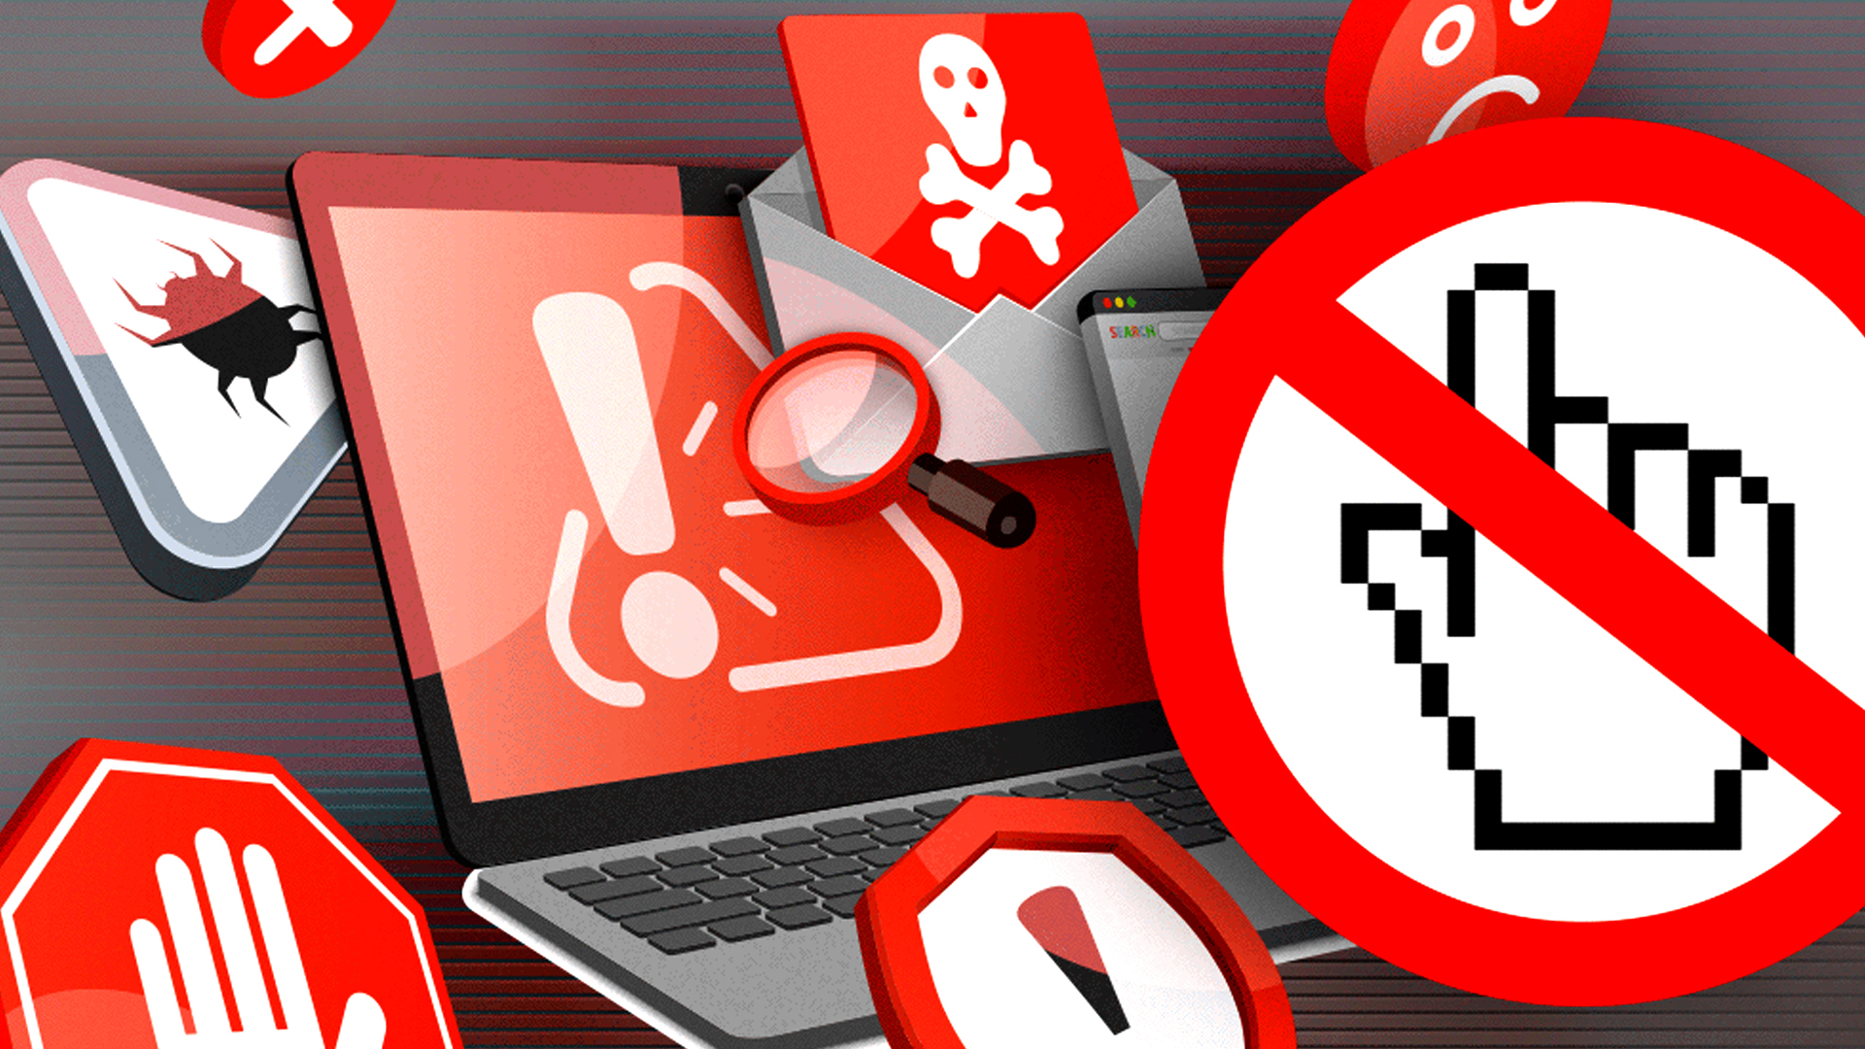
Don’t be tempted!
And don’t risk it!
The innocent and seductive link can cause a lot of harm!
Someone behind it can have malicious intentions.

Slide 9
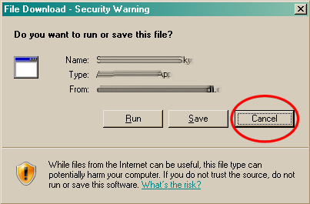
Important!
Do not download or run unfamiliar and unapproved files!!!

Slide 10
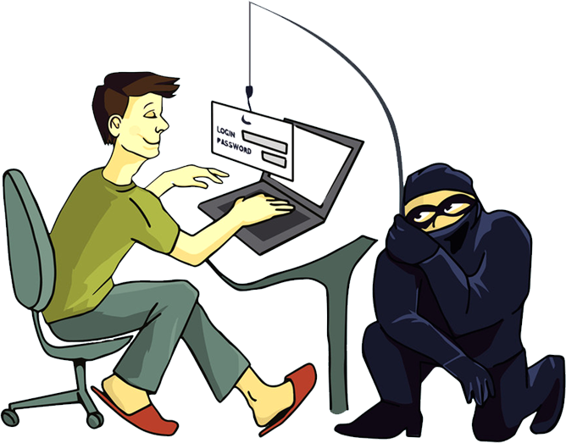
Watch out for suspicious emails:
Maybe the address looks a little strange…
Or you received a message that’s a little different
from the contact’s usual way of speaking…
*** Do not open it!
*** Especially, do not click any links or files!
Hackers can hack your contacts emails
Or open a new email that’s very similar to your contact's,
or even a familiar company.

Slide 11

It’s very important to keep Windows updated,
And the firewall active.

Slide 12

Who doesn’t belong?

Slide 13
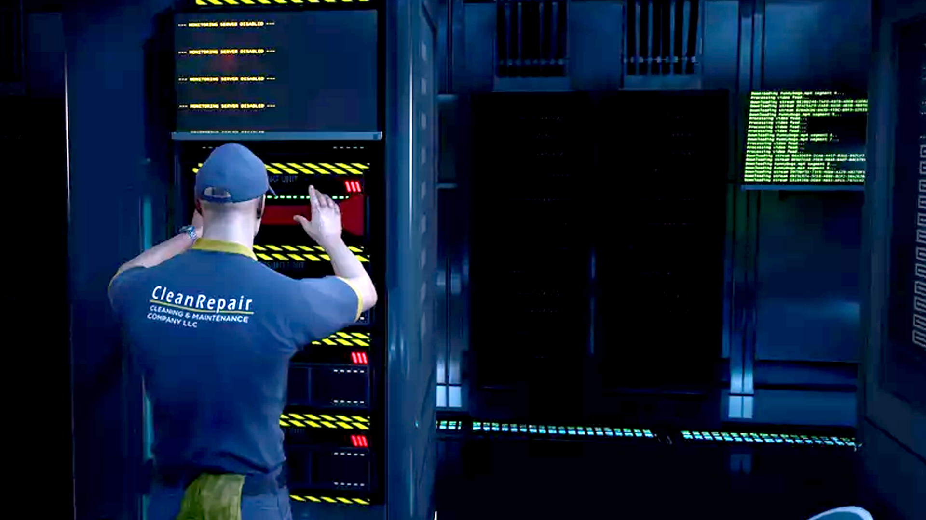
Recognize everyone around you?
Is there anyone you haven’t seen before?
Someone who maybe shouldn’t be present in the offices?
*** Pay attention ***
And alert any suspicious activity!!!

Slide 14
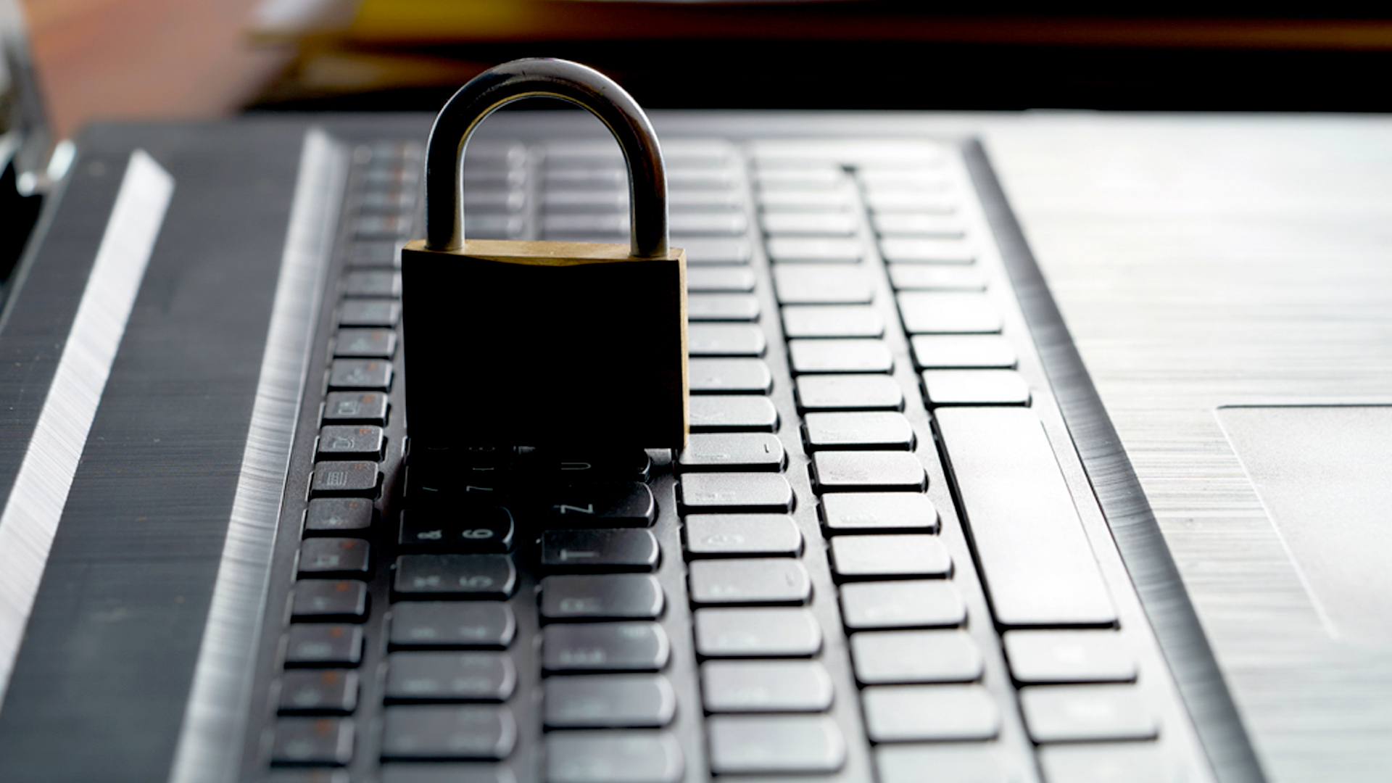
Mister CEO

Slide 15
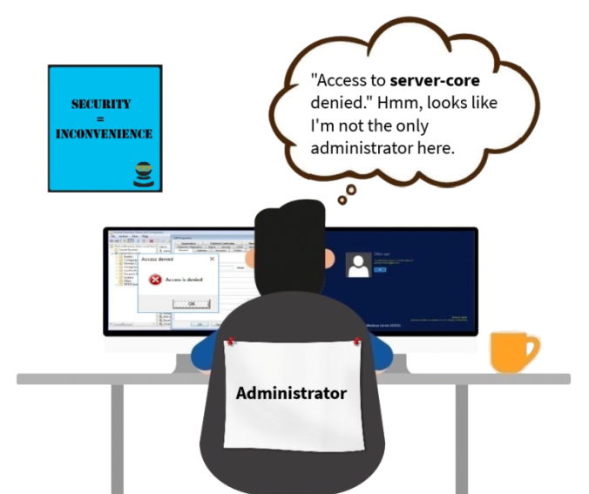
Admin access – only for the computer in charge of the company’s network!
Security = Inconvenience

Slide 16
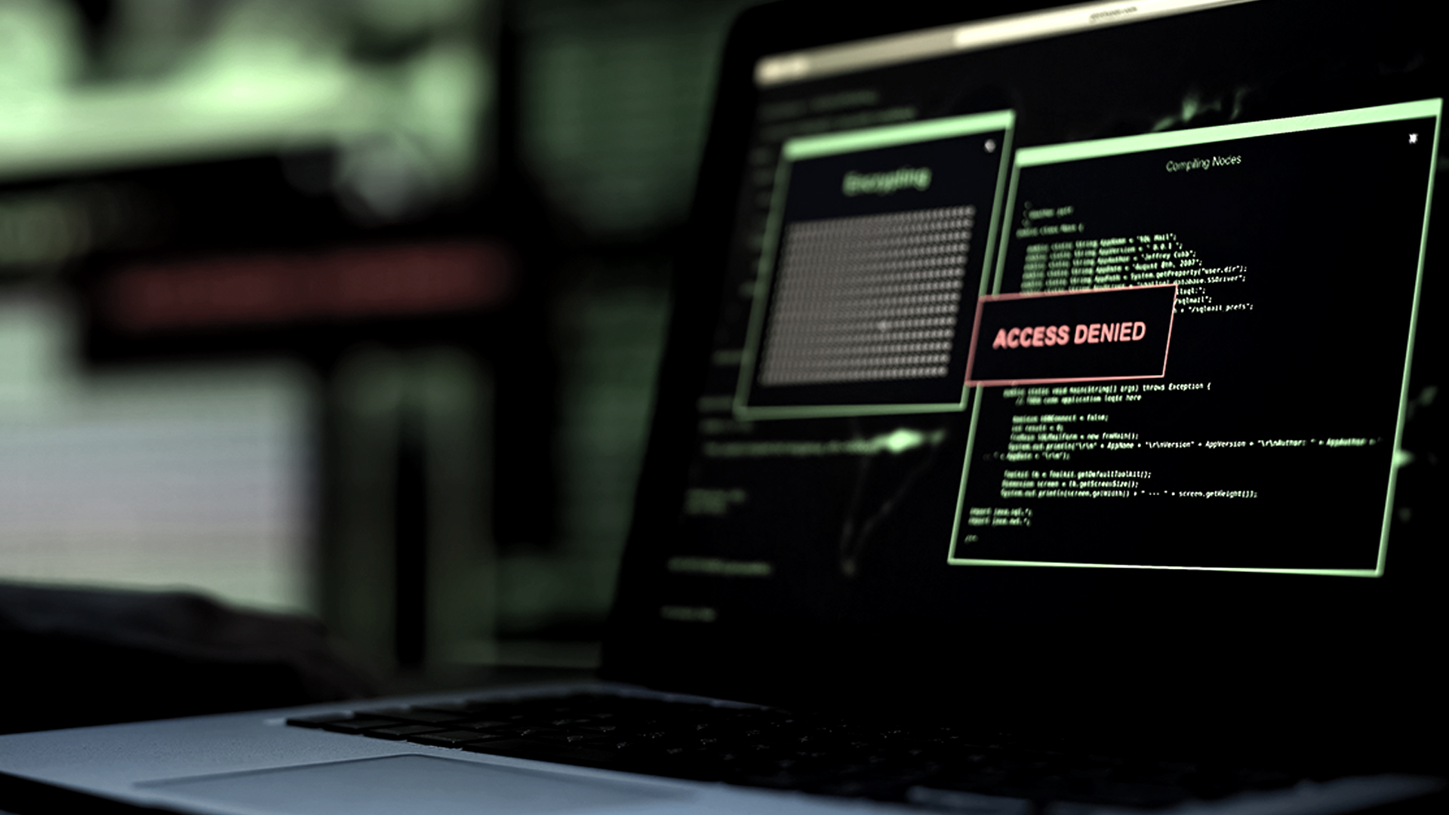
Every Admin access is a vulnerability, and can be a breach luring the hacker!
It’s recommended to reduce Admin access in order to minimize access points to the internal system.

Slide 17
In conclusion:
Create strong different passwords for each device and account,
and change them frequently
Be alert to suspicious or unfamiliar people who shouldn’t be around you
Pay attention to every link before clicking,
and do not download any unfamiliar or unapproved files!
Watch out for emails and email addresses – make sure you know the sender
Admin access – only for the main computer managing the company’s network!
Let’s protect the company’s information

